Slide 1

Ai in astronomy
By
Arun Ravi
Faleshwar Singh
Sai Krishna Madhav

Slide 2
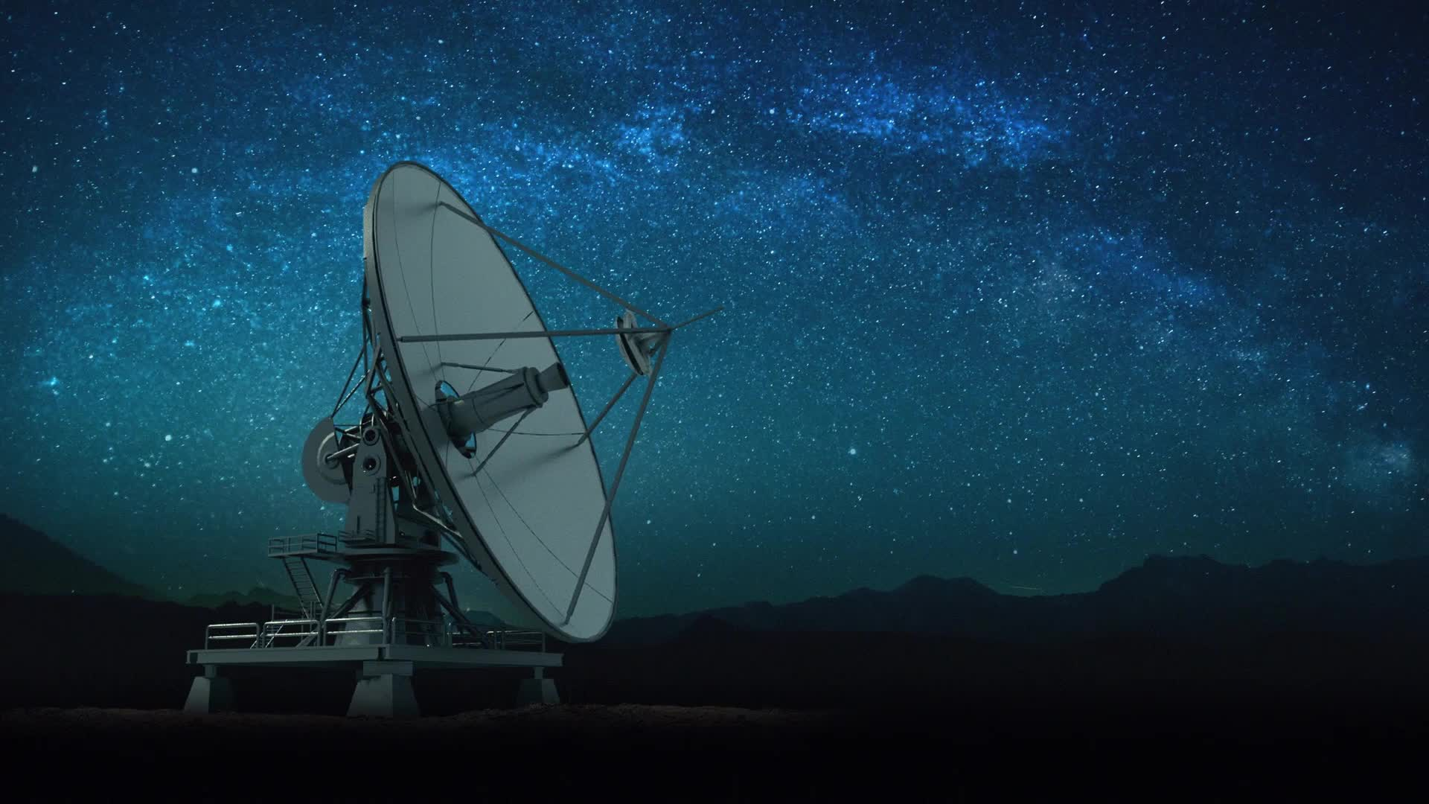
Applications of AI in Astronomy
Automated data processing
Image recognition and classification
Stellar and galaxy classification
Identifying exoplanets and searching for life beyond Earth
Predictive modeling and simulations
Discovering new celestial objects

Slide 3
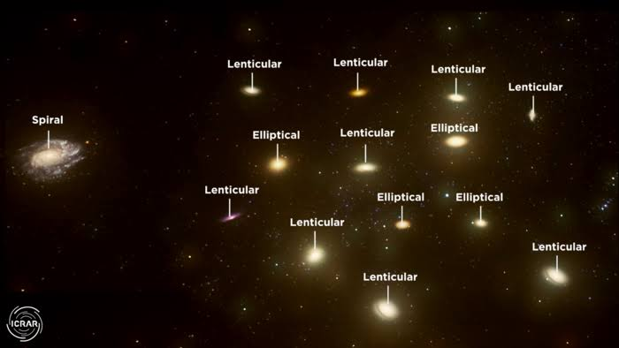
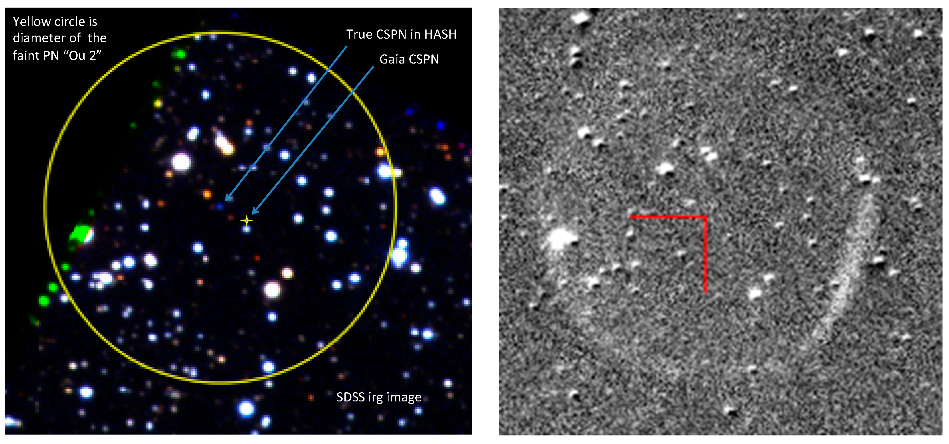

Slide 4

Current and Future AI Technology in Astronomy
The use of machine learning, deep learning, and neural networks in astronomy
Examples of current AI-driven astronomical projects and missions
Star and Galaxy Mapping
Planetary Geology (Astrogeology)
Satellite Operations
Advancements in AI technology and its potential impact on astronomy
Planet hunters

Slide 5
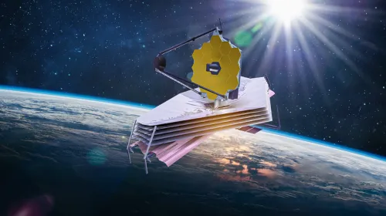
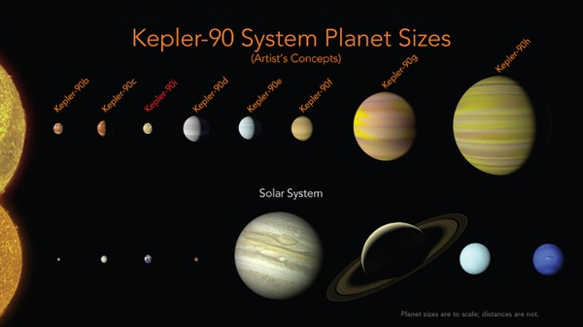

Slide 6
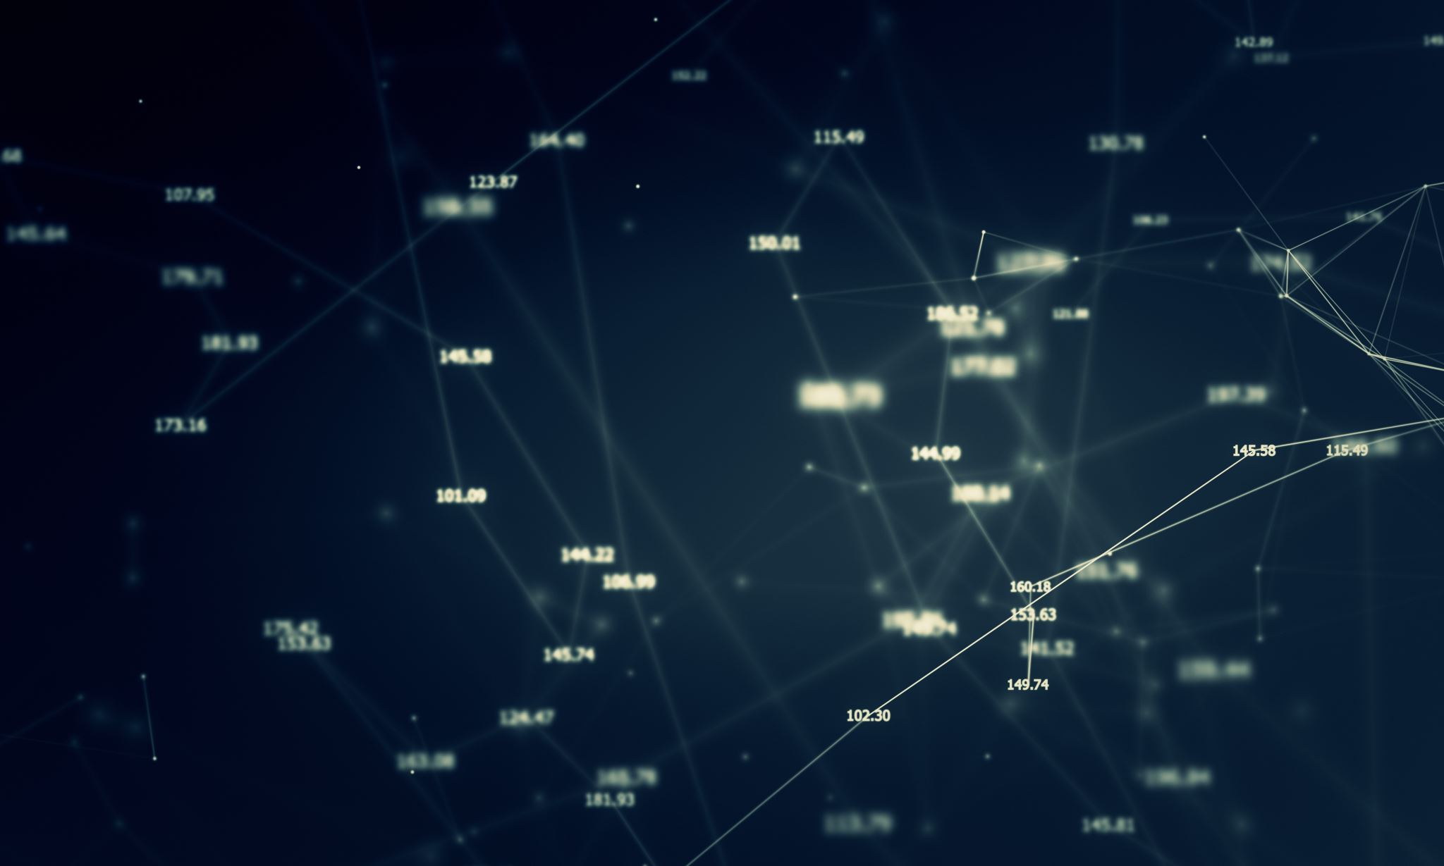
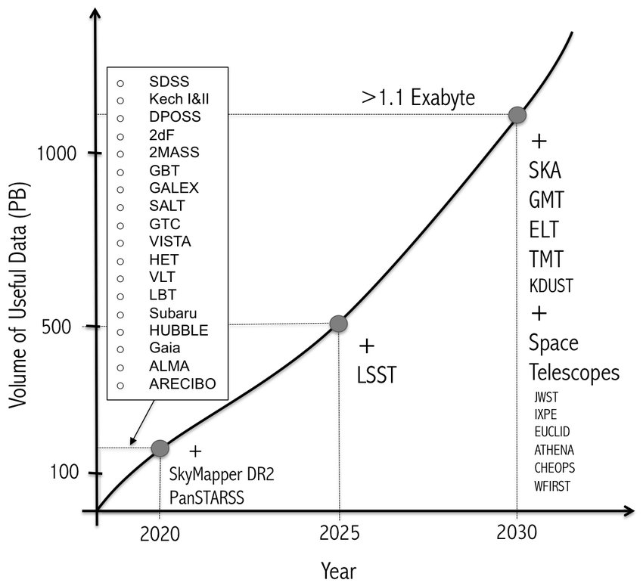
Benefits and Challenges of AI in Astronomy
Advantages of AI in astronomy, such as increased accuracy, efficiency, and productivity
Challenges of AI in astronomy, such as the need for large amounts of data, high computing power, and interpretability of results

Slide 7
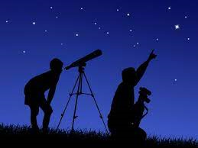
Ethical Considerations and Future Directions
Ethical considerations of AI in astronomy, such as data privacy, bias, and transparency
The role of AI in advancing our understanding of the universe and shaping the future of astronomy
Future directions of AI in astronomy, such as the development of new AI techniques and technologies

Slide 8
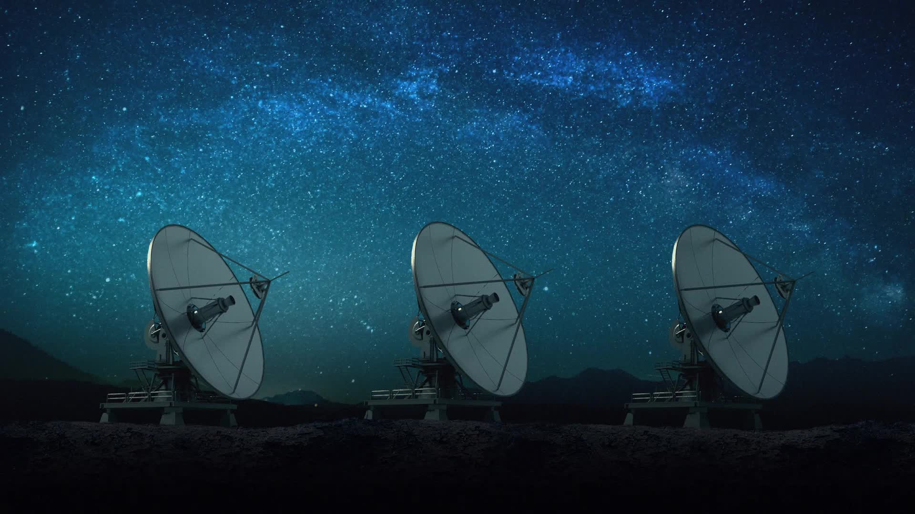
In summary, AI has a significant impact on astronomy, from processing large datasets to discovering new celestial objects. As AI technology continues to advance, its potential for transforming our understanding of the universe is immense. However, it is important to consider the ethical implications of AI in astronomy and ensure that it is used in a responsible and transparent manner.

Slide 9
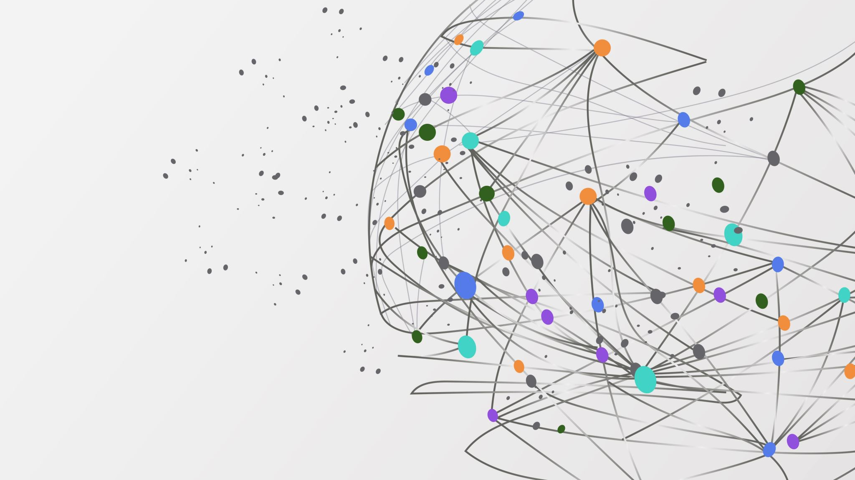
Thank you

